Slide 1
Properties of Matter
Physical
Chemical

Slide 2
Physical Properties
- a description of substances
colour
odour
texture
state (s, l ,g)
melting/boiling pt
(taste)

Slide 3
Characteristic Physical Properties:
unique to the substance
(like a person’s fingerprints or birthmark)
ex) - melting point
- boiling point

Slide 4
Chemical Properties
- properties that result from the way the particles that make up the substance are put together
THE way that they behave
Think WHMIS…. Explosive, toxic, flammable…

Slide 5
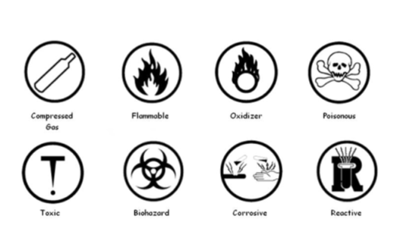

Slide 6
CHANGES
Physical
Chemical

Slide 7
PHYSICAL CHANGE
­The substance changes it’s state (s, l, g) but keeps its same chemical composition
Ex) melted, evaporated, froze
* something new is NOT formed
Water is still H₂0 whether it is ice, or liquid water

Slide 8
A change in
Size
Shape
State
Location
…BORING: paint is drying
….SAD: my ice cream is melting

Slide 9
CHEMICAL CHANGE
something NEW is formed!! EXCITING!
A rearrangement of the atoms
…….but how do you know?!
…………………………………….

Slide 10
INDICATORS:
: light is given off
: heat is given off
: gas bubbles form
: colour changes
: A different odour forms
: A SOLID (precipitate) forms
- can be sticky, solid, or jelly

