Slide 1
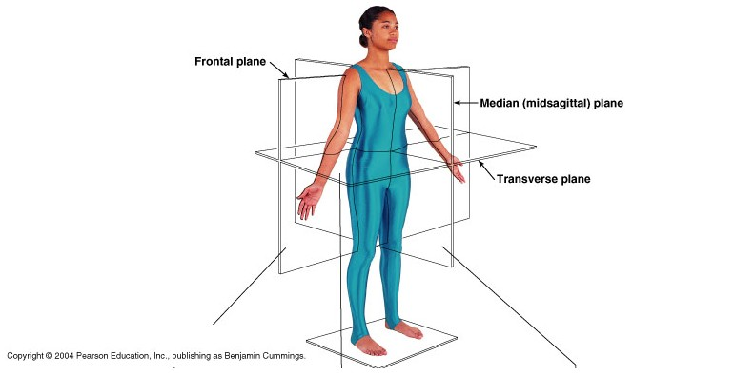
Body Planes, Directions, and Cavities

Slide 2
OK, sooooo…….
How would you describe where each of
the following organs is found:
the heart?
the spinal cord?
the kidneys?
the stomach?
the lungs?
the liver?
To study the anatomy and physiology of the body special terms are used to describe positions, locations and directions.

Slide 3
Describing the Human Body
Anatomical Position
- is the “starting point” for describing
positions and directions
- is a normal standing position
= upright with feet, face and shoulders
facing forward; arms down & palms
facing forward

Slide 4
Anatomical Directional Terms
- are like directions on a map
= can be used to describe the locations of structures
in relation to other structures or locations in the
body.
- each directional term has a
complementary one

Slide 5
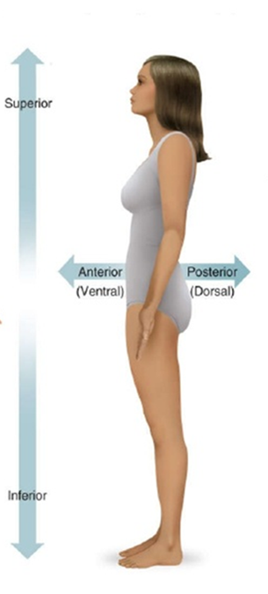
External: ­ on the outside
Internal: ­ on the inside
The ___________surface is covered with hair.
Superior (Cranial): ­toward the top
Inferior (Caudal):­ toward the bottom
The mouth is ___________to the nose.
Anterior (Ventral): ­towards the front
Posterior (Dorsal): ­ towards the back
The naval is on the ___________surface of
the body.

Slide 6
Superficial: ­ at the body surface
Deep: under the body surface
The patient had _____ wounds from a chain saw.
Proximal ­ near point of reference
Distal:­ away from reference point
The fingers are ________to the elbows.
Medial: toward the midline of the body
Lateral: away from the midline of the body
Your eyes are ________ to your nose.
Central: ­locations around the center of
the body
Peripheral: ­surrounding or outer regions
of the body
The patient had _________chest pains.

Slide 8
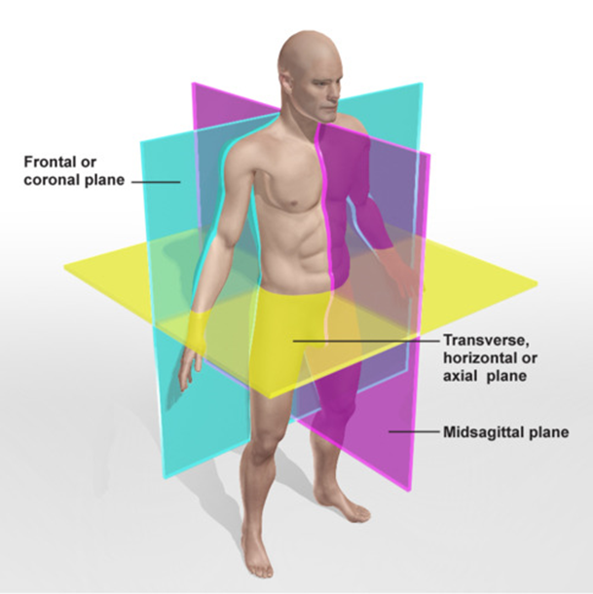
Anatomical Planes
- A plane is an imaginary line drawn through the body
or organ to separate it into specific sections.
- Directional terms create planes
-There are three body planes
https://www.youtube.com/watch?v=gxxy7AP_eGQ

Slide 9
Transverse Plane
= horizontal plane
- divides the body into a top & bottom half
- directional terms associated with transverse:
Superior – body parts above
Inferior – body parts below

Slide 10
Sagittal (Medial) Plane
- divides the body into a right and left side
- if the division is equal it is called Mid-Sagittal
- directional terms associated with mid-sagittal:
Medial –close to midline
Lateral –away from the midline

Slide 11
Frontal or Coronal Plane
- divides the body into front and back sections
- directional terms associated with frontal:
Ventral (Anterior) - in front of plane or front of the body
Dorsal (Posterior) - in back of plane or back of body

Slide 12
Sooooooo…….What if….
You are a surgeon and planning to do open heart surgery…. you would need to make a ________________ cut into the chest cavity.
You have a patient that has gangrene in the lower portion of their leg and you need to amputate….. You would make a ________________ cut through the leg.
The abdominal muscles and muscles of the back are separated by the _______________ plane.

Slide 13
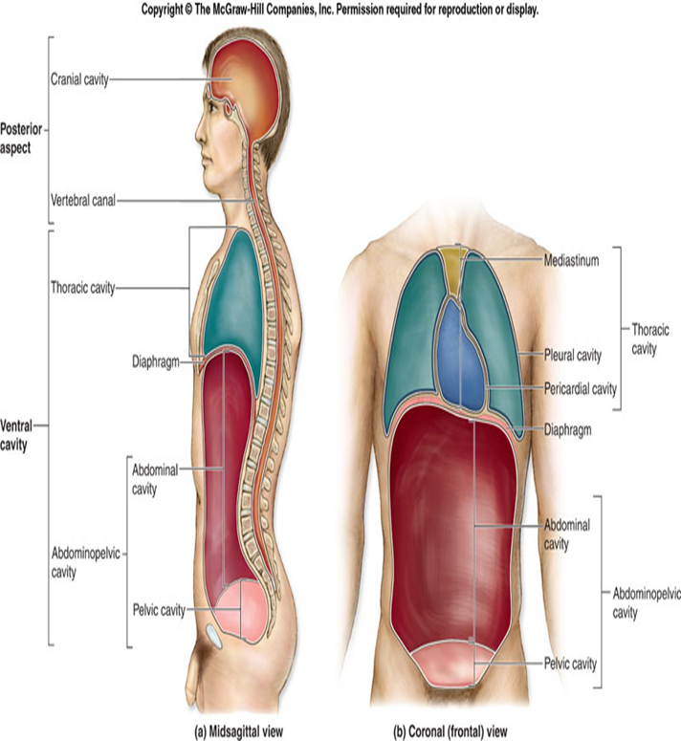
Body Cavities
= spaces within body that contain vital organs
- there are two main body cavities

Slide 14
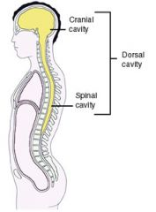
Dorsal Cavity
- one long, continuous cavity at the back of body
- divided into two sections, each surrounded by bone:
a) Cranial Cavity
- surrounded by skull
= contains the brain
b) Spinal Cavity
- surrounded by vertebrae
= contains the spinal cord

Slide 15
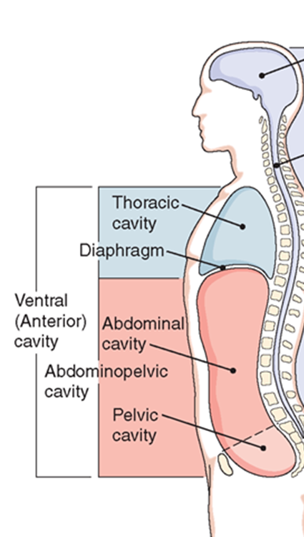
Ventral Cavity
- located on the front of the body
- divided into two cavities by the diaphragm
a) Thoracic Cavity
- upper chest or torso
- contains the heart and lungs
b) Abdominopelvic Cavity
- separated into upper & lower part
i) Abdominal Cavity
= contains digestive organs
ii) Pelvic Cavity
= contains the reproductive organs, bladder & rectum
**NO structure separates the Abdominal and Pelvic cavities

Slide 16
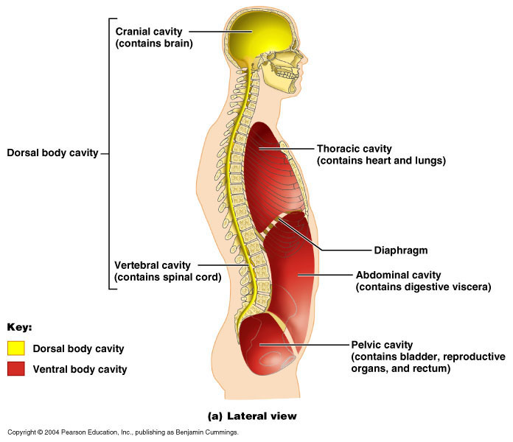

Slide 17
Transverse plane
Sagittal plane
Coronal plane
Superior
Inferior
Cranial
Caudal
Medial
Lateral
Anterior
Posterior
Dorsal
Ventral
Proximal
Distal
Word unScramble

Slide 19
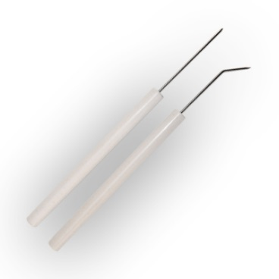
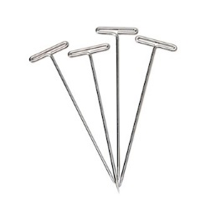
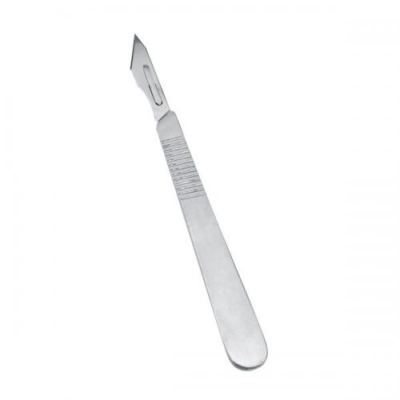
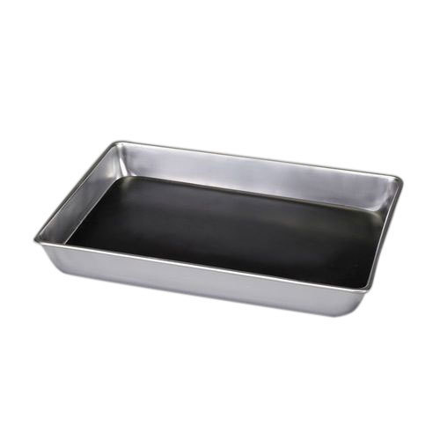
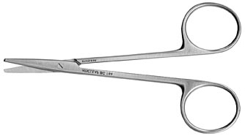
Dissection Tools
Forceps
Dissecting probes
Dissecting pins
Scalpel
Dissecting tray
Dissecting scissors

