Slide 2
Is the Climate Changing?

Slide 3
Is the Climate Changing?
Yes!

Slide 4
Is the Climate Changing?
Yes!
…But Earth's climate is always changing!

Slide 5
Is the Climate Changing?
Yes!
…But Earth's climate is always changing!
Throughout its 4.5 billion year history, Earth's climate has alternated between periods of warmth and relative cold, each lasting for tens to hundreds of millions of years.

Slide 6
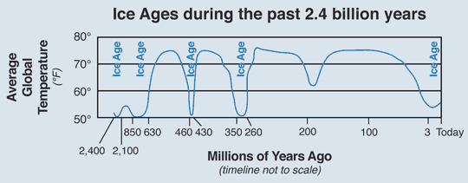

Slide 7
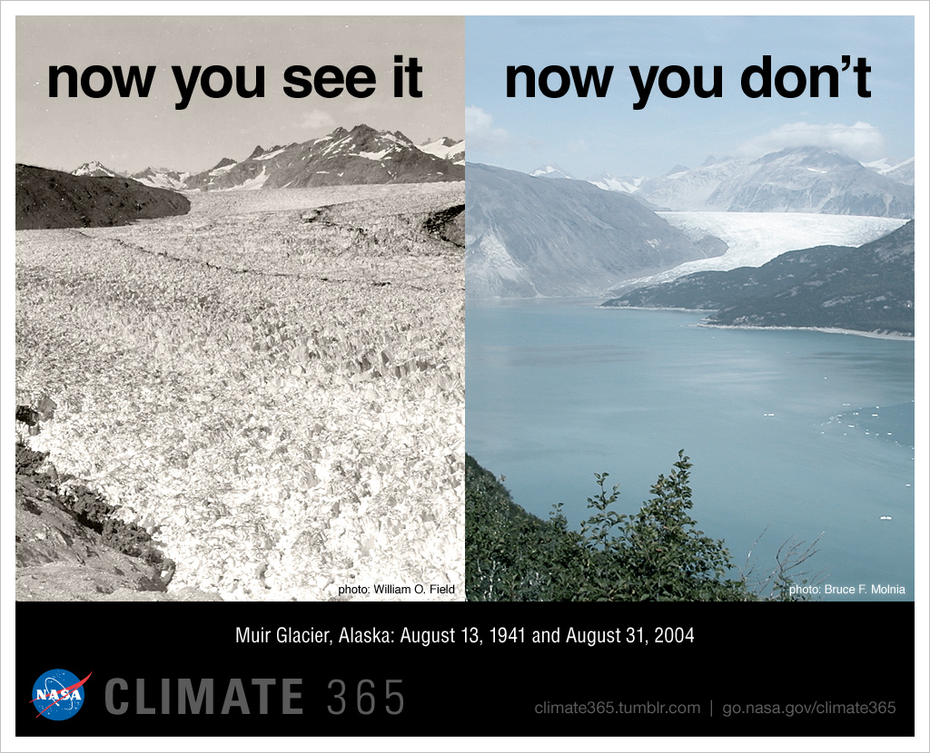
Is the Climate Changing?
But….the current rate of change has never been evidenced before!
Human actions are causing the climate to change faster than it ever has before!

Slide 8
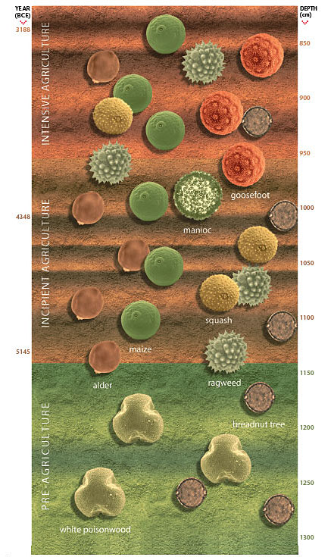
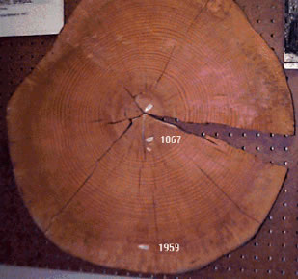
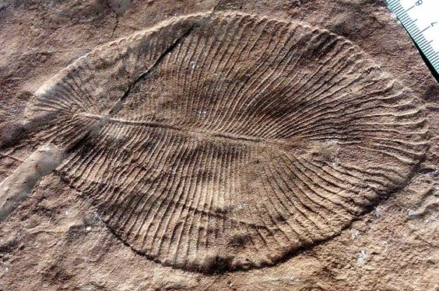
How do we know this?
Scientists study past temperature records by analyzing rocks, fossils, tree rings, pollen grains, and ice.

Slide 9
Ice Cores
Samples from ice fields show layers created by snowfall, which alternate with summer deposits of pollen and dust.
These layers provide physical timelines of glacial cycles.

Slide 10
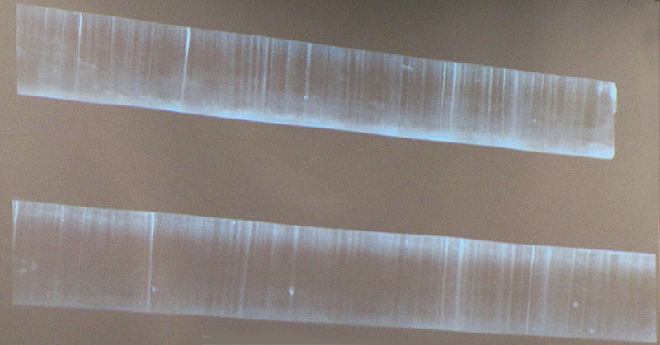
Ice Cores
Air bubbles in the ice can help measure atmospheric CO₂ levels at the time the ice was laid down.

Slide 11
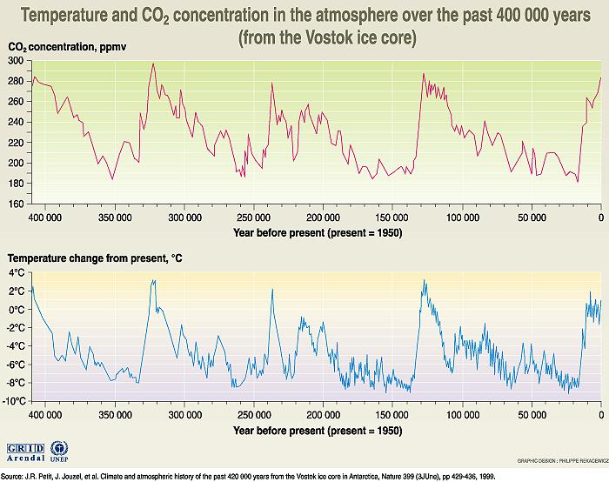
Ice cores show that atmospheric CO₂ levels
have never exceeded 300 ppm in the last 650,000 years.

Slide 12
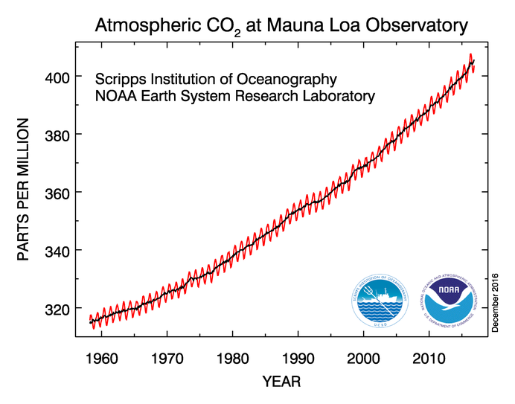
Today’s atmospheric CO₂ level is
404 ppm!

Slide 13
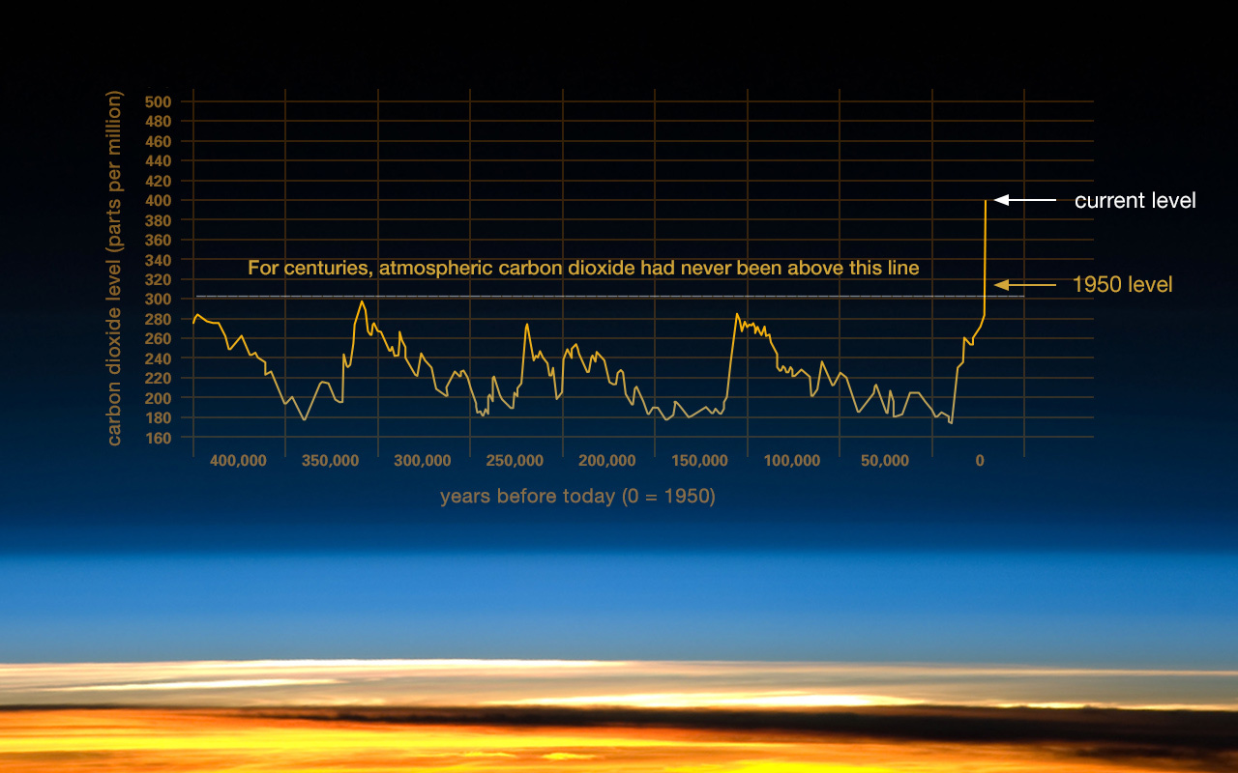
Atmospheric carbon dioxide is at its highest level in human history.

Slide 14
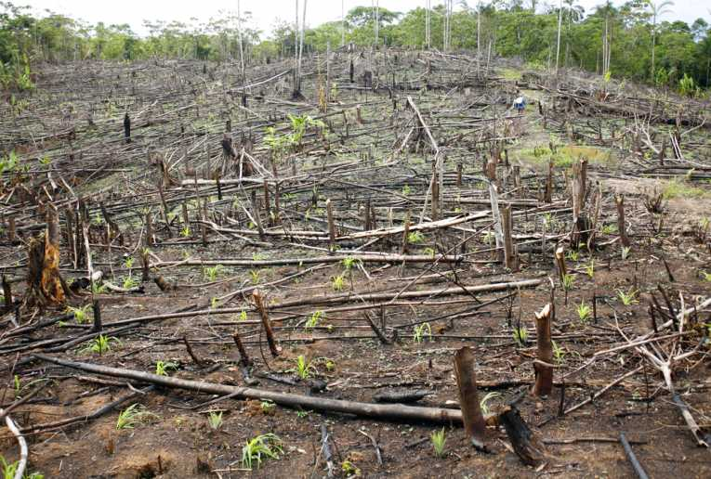
Increasing CO₂ levels
Scientists believe the increase in CO₂ levels is caused by human activities such as:
Burning fossil fuels
Deforestation
Agricultural practices
Industrial processes

Slide 15
Increasing CO₂ levels
Some of the excess CO₂ ends up in carbon sinks such as oceans and forests.
However, about half ends up in the atmosphere!

Slide 16
Anthropogenic Greenhouse Effect
As the concentration of CO₂ and other greenhouse gases (GHGs) increase, more energy is trapped and absorbed by the atmosphere.

Slide 17
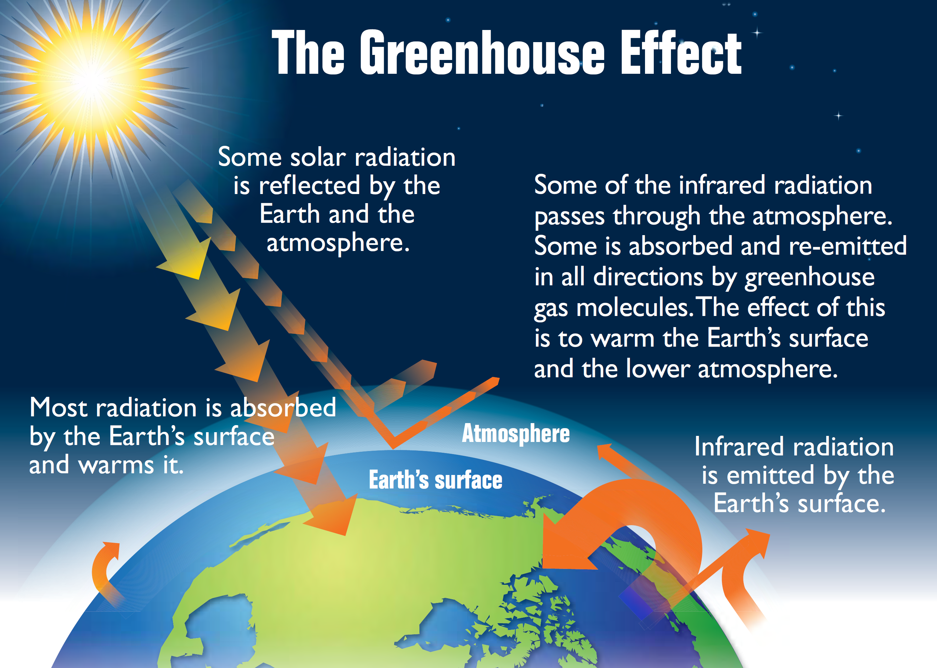

Slide 18
Anthropogenic Greenhouse Effect
This process is called the anthropogenic greenhouse effect.
Involves the same processes as the natural greenhouse effect but as human release more GHGs, Earth’s energy balance changes.

Slide 19
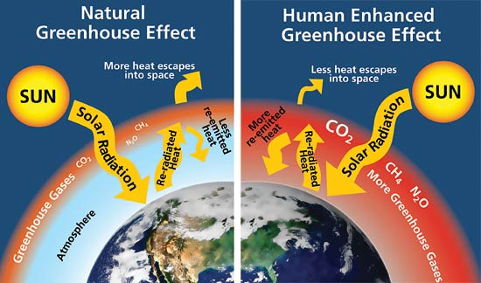
Anthropogenic Greenhouse Effect
More thermal energy is trapped inside the atmosphere, raising temperatures beyond what they would be from the natural effect alone

Slide 20
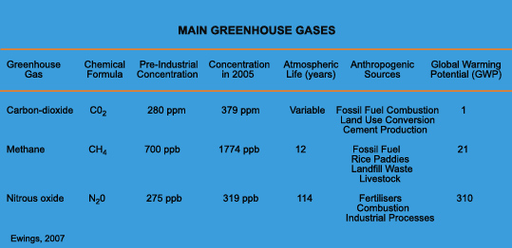

Slide 21
Anthropogenic Greenhouse Effect
The result is climate change!

Slide 22
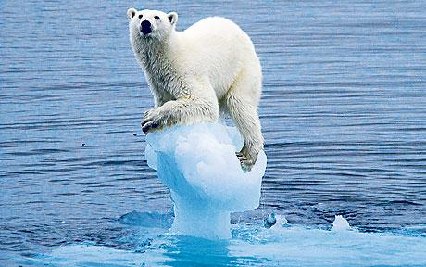
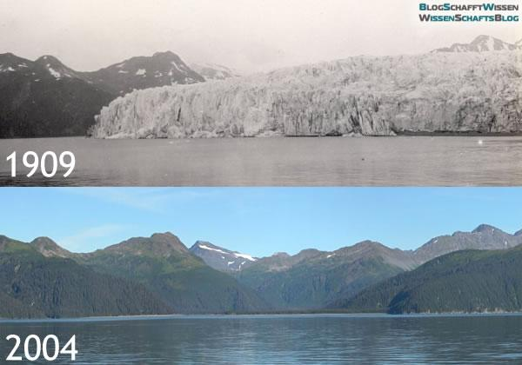
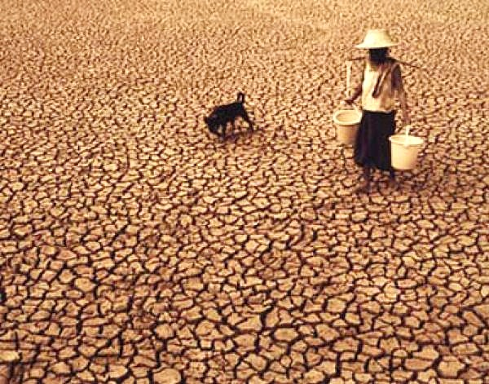
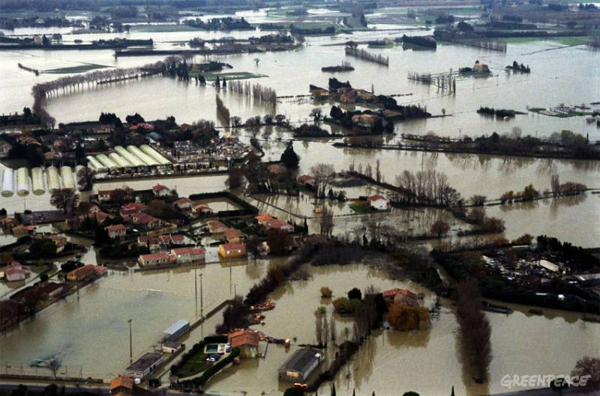
Climate Change
Occurs when long-term weather patterns (i.e. temperature, precipitation, extreme events) are altered.

Slide 23
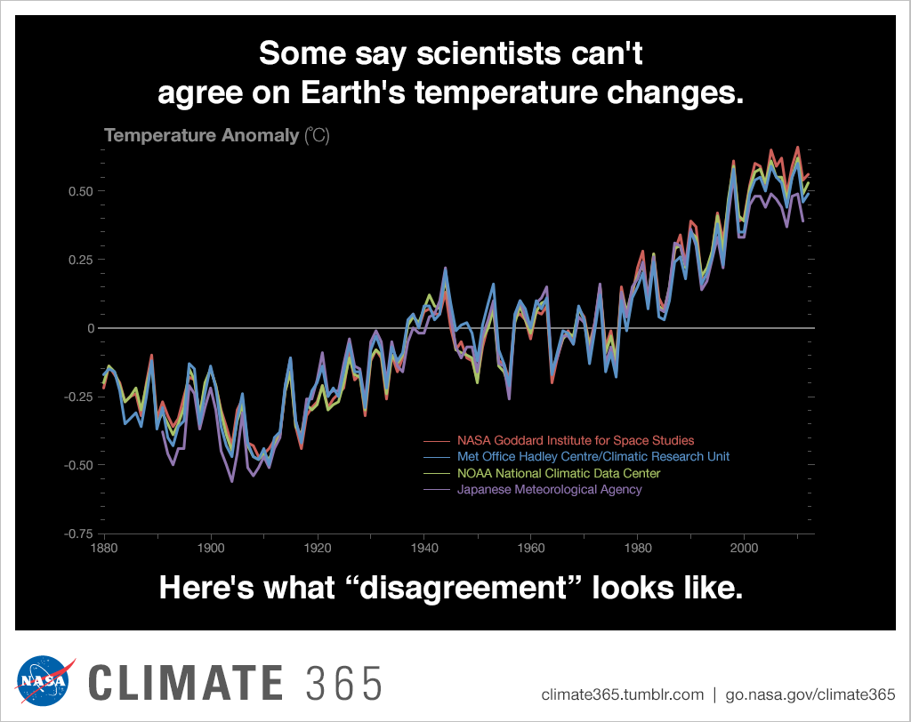
Global Warming
Is the rise in the average global temperature.
Data shows that the global average surface temperature has increased by 0.8ºC since 1900.
And is forecasted to rise 1.8° and 4.0°C in the next century.

Slide 24
Global Warming
So what…!?!
Small changes in temp mean HUGE changes in the environment.
E.g. During the last ice age, the global temp was only 5 to 9ºC cooler than today.
Other effects include…

Slide 25
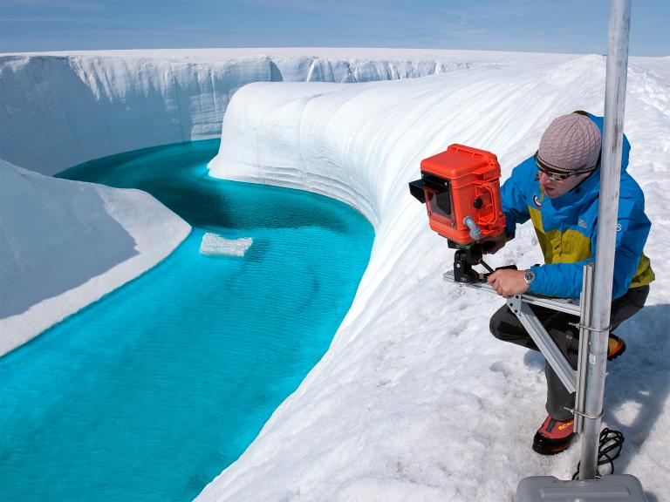
Ice Sheets Melting
The Greenland and Antarctic ice sheets have decreased in mass.

Slide 26
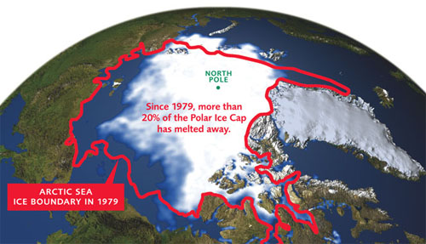
Ice Sheets Melting
Both the extent and thickness of Arctic sea ice has declined rapidly over the last several decades.

Slide 27
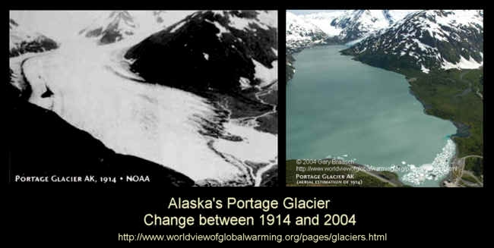
Glaciers Retreating
Glaciers are decreasing in size almost everywhere around the world.

Slide 28
Sea Levels Are Rising
Global sea level rose about 17 centimeters in the last century. The rate in the last decade, however, is nearly double that of the last century.

Slide 29
Other Aspects of Climate Change
Global Warming is only one measure of climate change!
Climate change also alters temperature patterns, meaning:
more intense and frequent heat waves
less frequent and intense cold waves

Slide 30
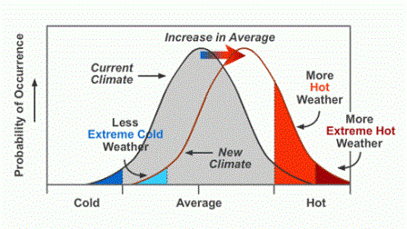
Other Aspects of Climate Change
Precipitation patterns are also impacted:
increased frequency and intensity of hurricanes
regional changes in floods, droughts, and wildfires

Slide 31
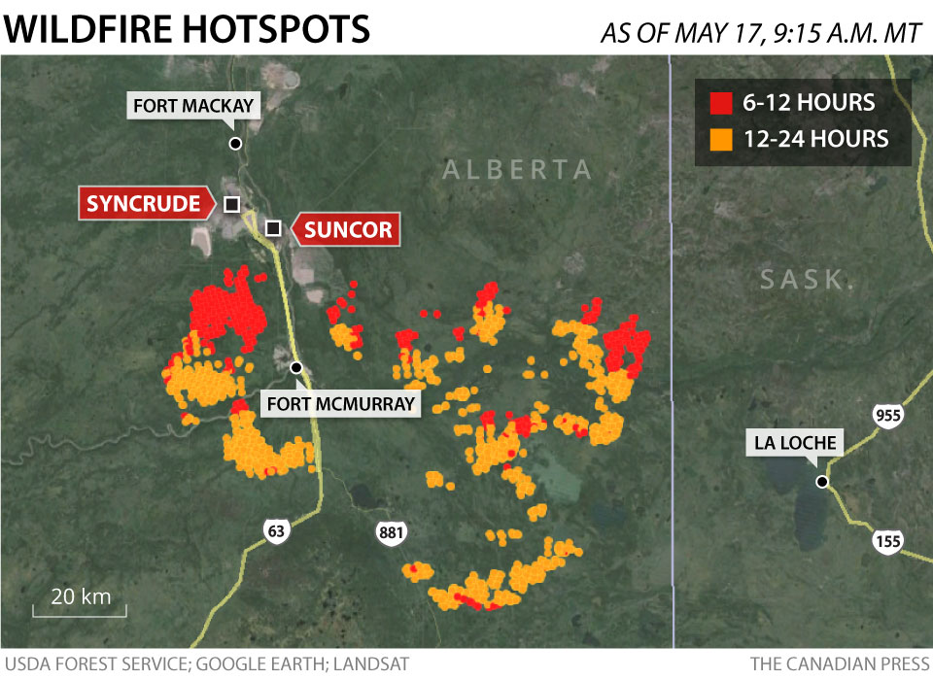
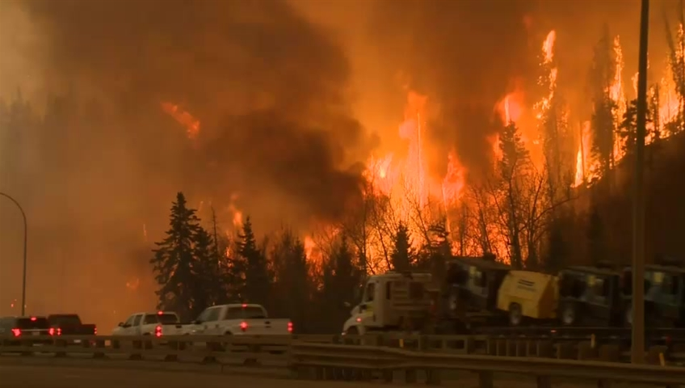
Consequences of Climate Change
More frequent wildfires

Slide 32
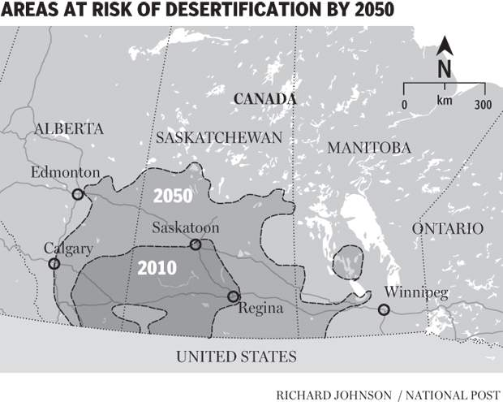
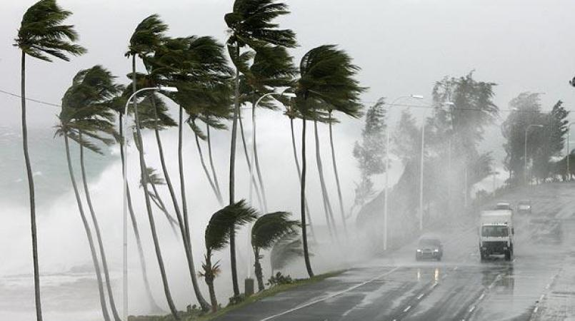
Consequences of Climate Change
Longer periods of drought and/or increased intensity of tropical storms depending on location

Slide 33
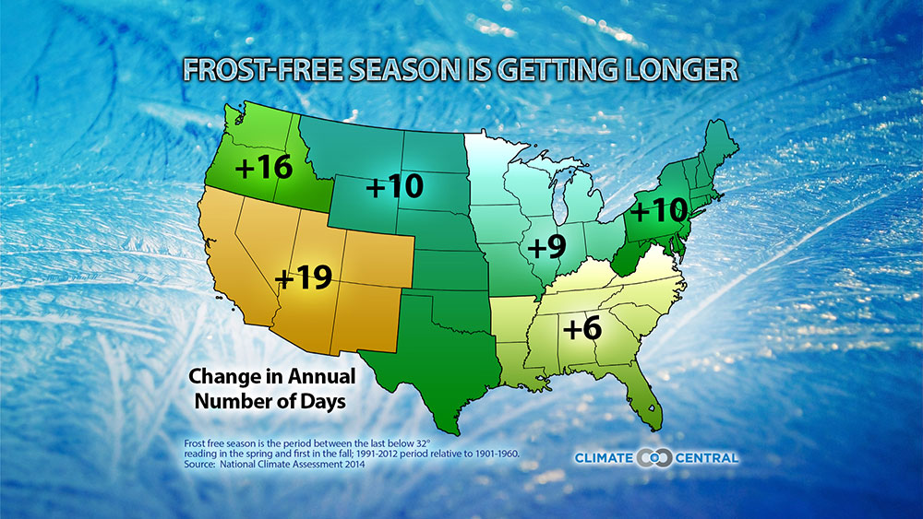
Climate Change: Effects
Frost-free season (and growing season) will lengthen
Change in biodiversity

Slide 34
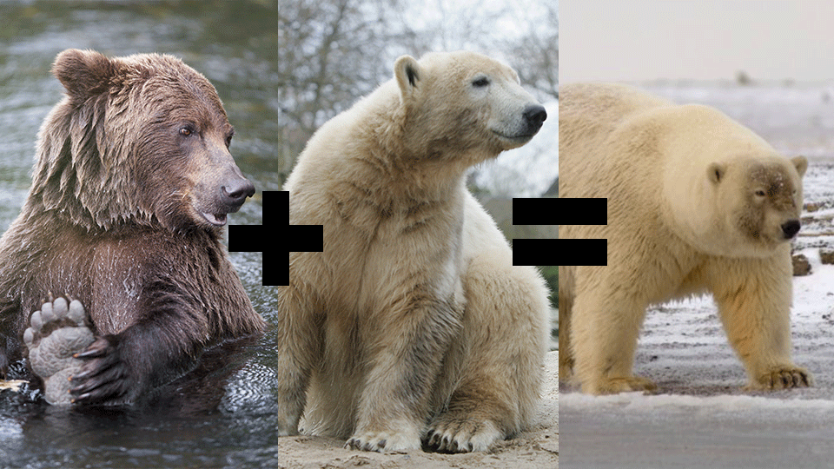
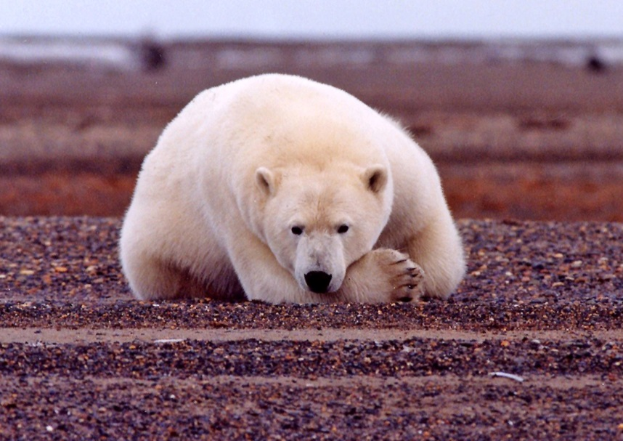
Climate Change: Effects
Arctic likely to become ice-free
Loss of biodiversity
Change in food chains/webs

Slide 35
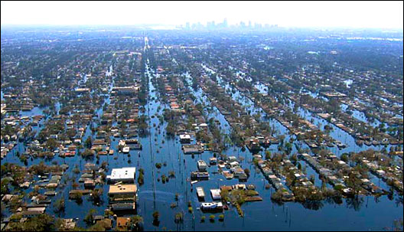
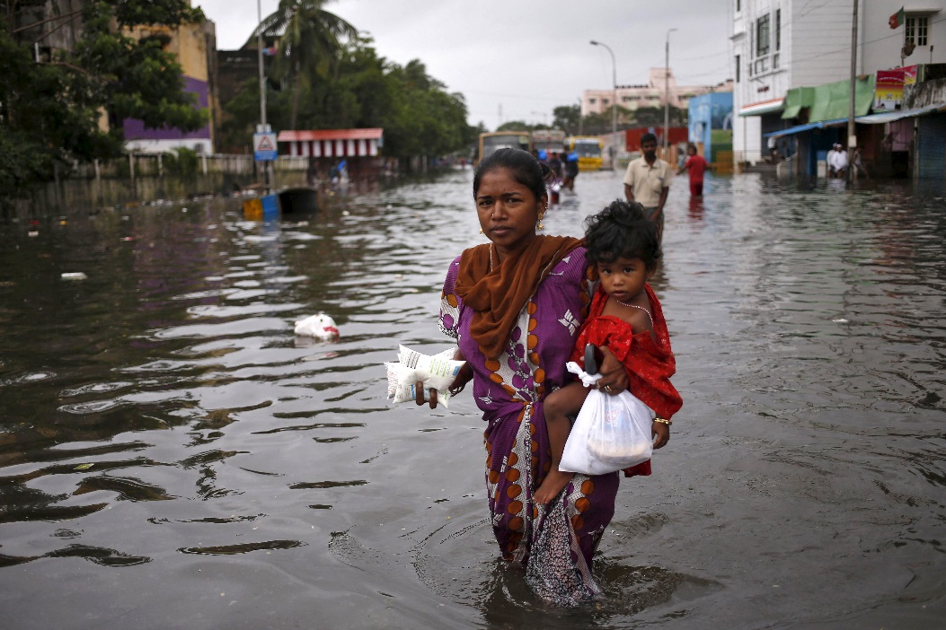
Climate Change: Effects
Sea level will rise 1-4 feet by 2100
Increase in Climate Refugees!

Slide 36
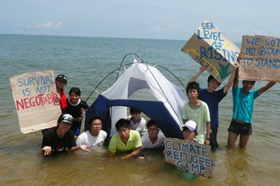

Slide 37
Vocabulary Building
Global Warming
Greenhouse
Greenhouse gases
Greenhouse effect
Fossil fuels
Atmosphere
Tilt the balance
Clear forests
Release
Absorb

Slide 38
Matching: The Effects of Global Warming
Mountain glacier d
Polar ice cap i
Shelf ice g
Heatwave a
Drought h
Wildfire k
Rising sea levels c
Unpredictable l
Coastal flooding J
Refugee crisis b
Climate change e
Extinction f

